Slide 1


Slide 2
Elements of E/R
An Introduction To E/R Model & Diagrams

Slide 3
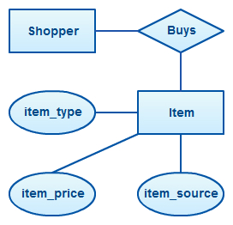
E/R Model
Consists of three core things:
Entities - Things
Attributes - Properties of Things
Relationships - Relationships between things
In this simple example
Entities: Shopper, Item
Attributes: item_type, item_price, item_source
Relationship: Buys
Notes:
Can be found online… but I can’t link to it

Slide 4
Entities
The core Nouns of a system
Somewhat akin to an Object in Object Oriented Languages
Does not encode actions as in OO
Represented by a rectangle in E/R Diagrams
Notes:
Can be found online… but I can’t link to it

Slide 5
Attributes
Information about an Entity
Can be a gray area between Attributes and Entities
Typically “primitive”
Integers, Strings, etc.
Make up the “data” of the Entity
Represented as an oval
Notes:
Can be found online… but I can’t link to it

Slide 6
Relationships
Indicates a relationship between entities
Represented by a diamond
Might be hiding another entity
Is “Buys” really a Purchase here?
Notes:
Can be found online… but I can’t link to it

Slide 7
Relationships
Indicates a relationship between entities
Represented by a diamond
Might be hiding another entity
Is “Buys” really a Purchase here?
Notes:
Can be found online… but I can’t link to it

Slide 8
Relationship Multiplicity
A relationship can have different multiplicity or cardinality
One-to-one
Employee to Job Position
One-to-many
Class to Student
Many-to-many
Buildings to Students
Notes:
Can be found online… but I can’t link to it

Slide 9
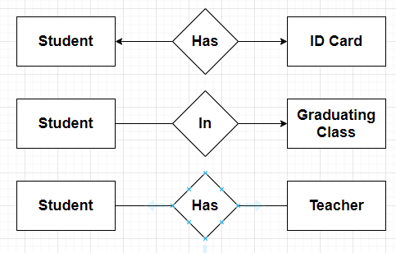
Relationship Notation
There are a lot of different notations
The book uses an older & infrequently used notation
Arrow head to entity indicates it is singular
Hard to read!
Unintuitive
Notes:
Can be found online… but I can’t link to it

Slide 10
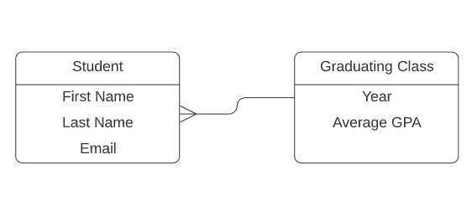
Relationship Notation
Much more common today is the “crow’s feet” notation
Less cluttered
Puts the indicator on the obvious side of the relationship
Notes:
Can be found online… but I can’t link to it

Slide 11
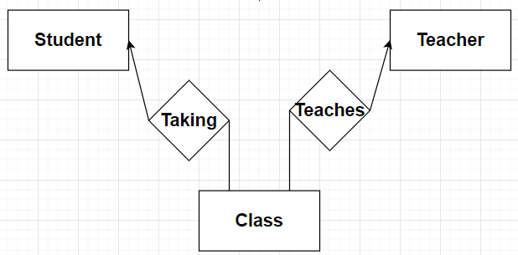
Many-To-Many… An Entity?
Many-to-many relationships are often an entity crying to get out
Consider our Student-Teacher example
This is really a Class Entity
Look to replace many-to-many with Entities with one-to-many relationships
Notes:
Can be found online… but I can’t link to it

Slide 12
E/R Constraints
Keys And So Forth

Slide 13
E/R Model
Recall, an E/R Model consists of three core things:
Entities - Things
Attributes - Properties of Things
Relationships - Relationships between things
Notes:
Can be found online… but I can’t link to it

Slide 14
Constraints
What about constraints on attribute values?
Is an attribute unique across instances?
Does an attribute refer to another attribute?
Must an attribute be one of a set of values?
These are an important facts that need to be captures by a model
Notes:
Can be found online… but I can’t link to it

Slide 15
Keys
Keys are a way to uniquely identify a entity in a set
Can be one or many attributes
May be multiple unique keys
But there is usually a Primary Key
The main key used for identity
E.g. The Shopper entity might have a primary key ShopperId
Notes:
Can be found online… but I can’t link to it

Slide 16
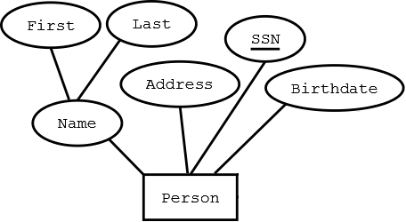
Keys
Attributes that are keys are represented by underlining the attribute name
Many of the book examples have entities with multiple keys
Rare in practice
Notes:
Can be found online… but I can’t link to it

Slide 17
Referential Integrity
A property of relationships
What if a Shopper purchased and Item, but the Item then is deleted?
This is clearer when we get into the Relational Model and how constraints are specified there
Notes:
Can be found online… but I can’t link to it

Slide 18
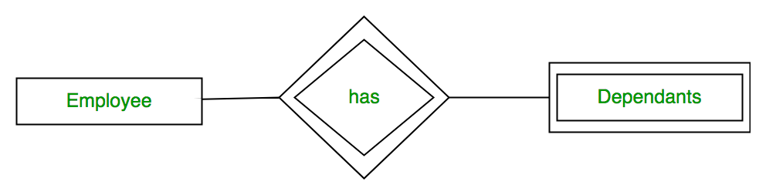
Weak Entities
A “weak entity” does not have a unique key of its own
I must include another entity set for uniqueness
Here, Dependants is a “weak entity”
Without the Employee, Dependent “Sam” is meaningless
Notes:
Can be found online… but I can’t link to it

Slide 19
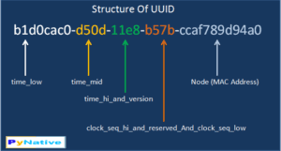
In The Real World
Every entity has a single, unique attribute, an ID
Traditionally this ID would be an unsigned integer
Sometimes referred to as a “synthetic key”
We are seeing more and more people use UUIDs
123e4567-e89b-12d3-a456-426614174000
Notes:
Can be found online… but I can’t link to it

Slide 20
The Real World
If everything has an ID…
No weak entities
No multi-key issues
I have never seen SSN used as a key
I bet some folks in government have...
I have, however, seen it used as a lookup
Notes:
Can be found online… but I can’t link to it

Slide 21
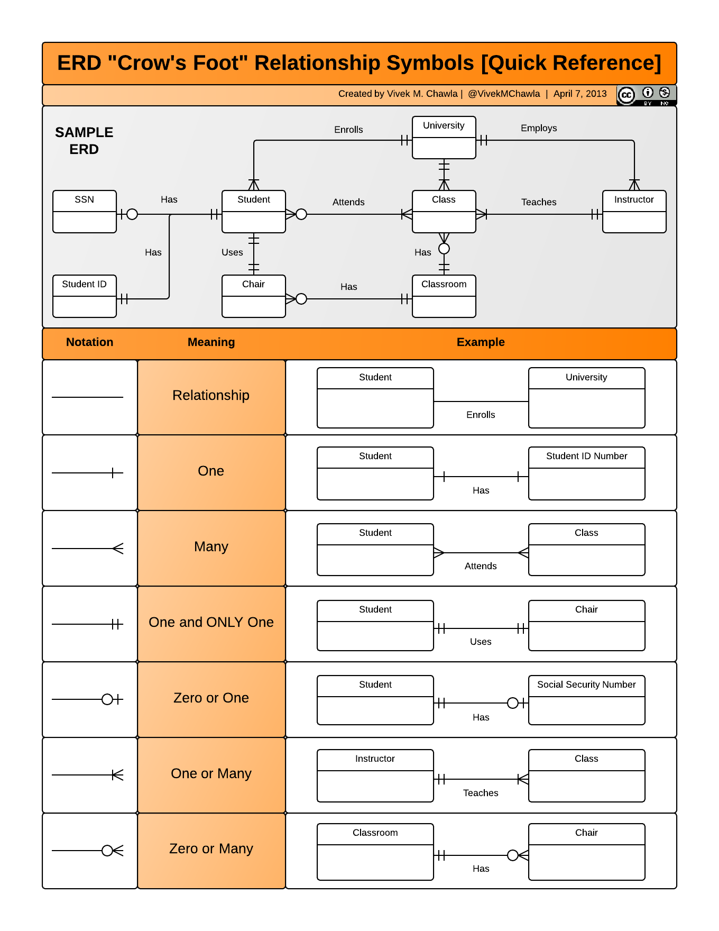
Modern “Crow’s Feet” Notation
Much clearer
Relationships are encoded in the lines directly

Slide 22
The Real World
I have only ever seen Crow’s Feet notation used
Cheat sheet available here: https://www.vivekmchawla.com/erd-crows-foot-relationship-symbols-cheat-sheet/
Please read over this E/R diagram over, it’s very good!
Notes:
Can be found online… but I can’t link to it

Slide 23

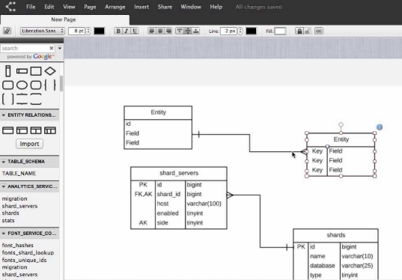
Industry
LucidChart is a popular tool https://www.lucidchart.com
You can sign up for a free account and play with it
Notes:
Can be found online… but I can’t link to it

Slide 24
Industry
How often are E/R Diagrams used in industry?
Sporadically
More frequent the larger the company is
Sometimes there is a stigma against E/R Diagrams
Often used at the start of a project, then abandoned as project matures
Notes:
Can be found online… but I can’t link to it

